Slide 1
Compositional Data Analysis: a better way to analyze high throughput sequencing data
Greg Gloor
Dep’t of Biochemistry
University of Western Ontario

Slide 2

Better quote than he realized?
There are known knowns. These are things we know that we know.
There are known unknowns. That is to say, there are things that we know we don't know.
But there are also unknown unknowns. There are things we don't know we don't know.
There are also things we think we know that we don’t know
Donald Rumsfeld

Slide 3
One category that he missed
There are known knowns. These are things we know that we know.
There are known unknowns. That is to say, there are things that we know we don't know.
But there are also unknown unknowns. There are things we don't know we don't know.
There are also things we think we know that we don’t know

Slide 4

Sequencing data are high-dimensional
Therefore statistical analyses can be wildly optimistic
Sequencing data are sparse
Therefore we need to estimate many of our values
Sequencing data are constant sum
Therefore we have compositional data
Most of us are unaware of the problems

Slide 5
The biggest problem is -
Sequencing data are high-dimensional
Therefore statistical analyses can be wildly optimistic
Sequencing data are sparse
Therefore we need to estimate many of our values
Sequencing data are constant sum
everything correlates with everything
Most of us are unaware of the problems

Slide 6
Where does data come from?
DNA or RNA fragments from the environment
A random sample used to make a library
A random sample of the library is sequenced and mapped
This generates a table of counts per feature (OTU, gene) in each sample
The number of reads is determined by the machine!
Gloor et al. 2016. Ann. Epidem.
Gloor et al. 2016. Can. J. Micro.
Notes:
Many more fragments than we can count

Slide 7
Random sample of environment
👽
👽
👽
👽
Notes:
Starting with a of molecules composed of Tigers and Ladybugs
We take a random sample, how many Tigers and how many Ladybugs
If we count a given random area we can infer how many off each there are in entire set

Slide 8
Counting our things
🐯
🐞
👽
Example 100 random sample sets
range=1800-2200
range= 8000-12000
range=450-550
🐯
🐞
👽

Slide 9
HTS is not counting
🐯
🐞
👽
Sequencing is a constant-sum operation
We only get the number of reads that the machine can deliver
Any constant sum is equivalent
Gloor, et al. 2016. Ann Epidemiology
Gloor, et al. 2016. Can J. Micro

Slide 10
Effect of a constant sum?
🐯
🐞
👽
Constant sum of 1000
Constant sum operations:
Count normalization
Rarefaction
Proportion
percentage, relative abundance
RNA-seq, metagenomics, tag-sequencing
Gloor, et al. 2016. Ann Epidemiology
Gloor, et al. 2016. Can J. Micro

Slide 11
We are working in the wrong geometry
🐯
🐞
👽
Correlation/covariation
Ordination (PCA), clustering, networks
Subcompositonal incoherence
Normalization, rarefaction, subsetting, aggregation
Noise is greatest at low count margin
Often ‘most significant’ is least abundant

Slide 12
Correlation and subcompositions
 | A | B | C | D
A | 1 | -0.69 | -0.99 | 0.36
B |  | 1 | 0.59 | -0.93
C |  |  | 1 | -0.25
D |  |  |  | 1
🐯
🐞
👽
 | A | B | C | D
S1 | 470 | 66 | 839 | 751
S2 | 541 | 569 | 787 | 512
S3 | 167 | 906 | 959 | 504
4
count
 | A | B | C | D
A | 1 | -0.77 | -0.30 | 0.55
B |  | 1 | -0.37 | -0.96
C |  |  | 1 | 0.62
D |  |  |  | 1
 | A | B | C | D
S1 | .221 | .031 | .394 | .353
S2 | .224 | .236 | .327 | .212
S3 | .066 | .357 | .378 | .199
4
composition
 | A | B | C
S1 | .348 | .048 | .610
S2 | .285 | .299 | .414
S3 | .082 | .445 | .471
 | A | B | C
A | 1 | -0.89 | 0.43
B |  | 1 | -0.79
C |  |  | 1
3 sub-
composition
Gloor et al. 2016. Ann. Epidem.
Gloor et al. 2016. Can. J. Micro.

Slide 13
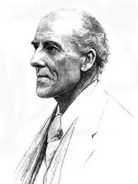
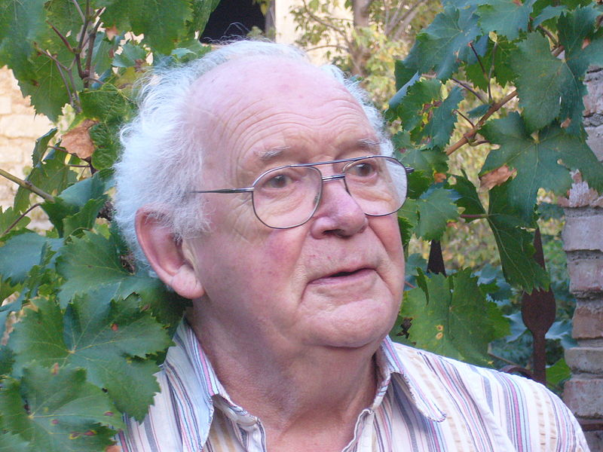
Compositional Data
🐯
🐞
👽
Compositional data are logically inconsistent with most tools in common use (Pearson 1897)
correlation, PCA etc.
negative binomial, rarefaction,
The solution is to work in terms of relative difference (ratios)
Aitchison and others
Conceptually similar to qPCR

Slide 14
Only have ratio information
Count
Sequencing
Simplex
🐯
🐞
👽
27
853
66
740
112
216
X = [ x₁, x₂, … x_{D} ], g_{X} = geometric mean of X
clr(x) = [ log(x₁/g_{X}), log(x₂/g_{X}), … log(x_{D}/g_{X}) ]
Measurements are now ratios between parts
Abundance is not directly represented in the output
Values are now unconstrained, but still on the simplex
The clr correction is scale invariant
Ratios are linearly related
Must delete, estimate or replace 0 values
Aitchison 1986. Stat. Anal. Comp Data
Pawlowsky-Glahn, 2015. Mod. Anal. CoDa

Slide 15
CoDa properties & problems
Count
Sequencing
Simplex
🐯
🐞
👽
27
853
66
740
112
216
Simplex: one fewer dimension than datapoints
Scale dependence - hence ‘normalization’
Correlation and covariation are unreliable
Subsetting and aggregating are problematic
Addition and subtraction are not useful operations
Sparse data becomes an issue
Problem remains regardless of dimension
It just ‘looks’ OK
Aitchison 1986. Stat. Anal. Comp Data
Pawlowsky-Glahn, 2015. Mod. Anal. CoDa

Slide 16
But my data are not affected …
🐯
🐞
👽
Transcriptome
Remove rRNA, tRNA, snRNA, etc.
Or only mRNA, snRNA, tRNA, etc.
16S rRNA gene sequencing
Primer bias
Remove low-count, singletons, sparsity, chimeric, etc.

Slide 17
The problem of 0
🐯
🐞
👽
A count of 0 …
Essential 0: the variable can never be observed
Structural 0: the variable can be observed but we missed it because of sampling
Compositional 0 replacement strategies
Remove essential 0 values
Replace or estimate structural 0 values
Prior to clr transformation
Best approaches are Bayesian but an open problem

Slide 18
Analysis tools based on variance of the ratios between parts
🐯
🐞
👽
Exploratory data analysis
Outliers
Differential abundance
Compositional association

Slide 19
Exploration: CoDa PCA biplot
OTU
A
B
🐯
🐞
👽
Data Structure
Exploratory Tool
Samples + Variables after clr
SVD is now legal
But is on ratios
Links are informative
Distance from origin ~ SD
Links ~ ratio abundance
Links with multiple tips ~ linear dependence
Cos angle between links ~ correlation of the parts
Gloor, et al. 2016. Ann Epidemiology
Gloor, et al. 2016. Can J. Micro
Notes:
Example dataset from vaginal microbiome. The CoDa principle component biplot shows the variance in the samples (red, blue) and operational taxonomic units (OTUs) in black, on the same scale. It is important to note that there is no information on abundance in these plots, only variance. The distance of an OTU from the origin approximates the standard deviation, so L. iners is the most variable in this dataset.
The links between tips approximate the ratio abundance correlation of the OTUs. So the ratio abundance of L. iners and L. crispatus, for example, will be relatiely constant across samples, while the ratio between L. iners and Atopobium (for example) will be linearly different. When one is abundant the other is rare.
Links that cross multiple tips will show a linear multiway dependence
The cosine of the angle between links approximates the correlation between ratios. So the ratio between L. iners and Atopobium, will be independent of the ratio between Lactobacillus and Sneathia

Slide 20
Generally robust to filtering
🐯
🐞
👽
OTU
BM
TD
HMP dataset, BM vs. TD
4776 OTUs in 366 samples
187 tongue, 179 cheek
Very sparse
Variance ratios between remaining taxa are constant across filtering methods
Gloor et al. 2016. Ann. Epidem.
Gloor et al. 2016. Can. J. Micro.
Notes:
In the HMP ongue and cheek dataset, we can examine the compositional biplot of the entire dataset (after 0 substitiution and clr transformation), and see that the tongue and cheek samples separate well. This separation is robust to three different types of filtering.
We can remove low variance OTUs, rare OTUs or OTUs that are present only in a few of the samples.
In all cases we preserve the separation that we saw in the entire dataset.
This works because we are examining the ratios between variables, not the abundance of variables. Thus, we are maintaining the ratios for the variables in common between the entire dataset and the sub-sets. This idea of sub-compositoinal coherence (non-contradictory answer upon subsetting) is central to the CoDa approach

Slide 21
Outliers
🐯
🐞
👽
Yeast transcriptome dataset
2 conditions WT, ∆SNF2
48 replicates
Tightly controlled conditions
All should be very similar
PCA plot of scores shows two major things
The two conditions split
There is considerable spread within conditions
Finding and removing outliers may improve our resolution
Data from Schurch, 2015

Slide 22
Outliers
🐯
🐞
👽
Yeast transcriptome dataset
Can we use location on component 2?
Yes but, is different for each group
Not obvious what the cutoff should be
What is special about component 2?

Slide 23
Outliers
🐯
🐞
👽
Yeast transcriptome dataset
Contribution to total variance?
Density shows approximate normal with tails
Outliers often defined as those beyond twice mean + IQR
Removes 7 SNF2, 5 WT samples
Same set as removed by Schurch et al, with a more complex linear combination model of correlation, X², and fraction of ‘bad’ gene levels
Simple, quick approach

Slide 24
Outliers
🐯
🐞
👽
Yeast transcriptome dataset
More variance explained on component 1, less on component 2.
Reduced component 2 variance by half
True spread of the data is easier to see
WT is more variable than SNF2

Slide 25
Outliers in gene tag sequencing data
HMP dataset
BM
TD
🐯
🐞
👽
Notes:
Switching to the Human microbiome (HMP) dataset, and examining a set of bucchal mucosa (cheek) and tongue dorsum microbiome samples, we can see that the data will be exceedingly sparse.
We can use a method similar to that suggested by Schurch to identify samples that are outliers, but on clr-transformed data this is much easier since we have a natural distance metric in clr transformed data-the Aitchison distance which is the euclidian distance between clr-transformed samples.
In general we should discard outlier samples since they add noise. However, you must know the partition of the data beforehand

Slide 26
We are working in the wrong geometry
🐯
🐞
👽
Correlation/covariation
Ordination (PCA), clustering, networks
Subcompositonal incoherence
Normalization, rarefaction, subsetting, aggregation
Noise is greatest at low count margin
Often ‘most significant’ is least abundant
Fernandes, et al. 2013. PLoS ONE
Fernandes, et al. 2014. Microbiome
Gloor et al. 2016. Aus. J. Statistics

Slide 27
Where is the noise?
Variance vs. mean for data on the simplex
Transcriptome datset
Top shows absolute data, with near linear dependence
Modeled by negative binomial
Lowest and highest counts have least variance
0 is 0!
Inflates statistical significance at low count margin
Bottom shows relative data, non-linear dependence on ratios
Follows approximate Dirichlet
Lowest and highest counts have least variance, but 0 is 0!
Inflates statistical significance at low count margin
🐯
🐞
👽
Fernandes, et al. 2013. PLoS ONE
Gloor et al. 2016. Aus. J. Statistics

Slide 28
Bayesian estimate
🐯
🐞
👽
Variance vs. mean for data on the simplex
Top shows point estimate
Follows approximate Dirichlet
Lowest and highest counts have least variance, but 0 is 0!
Inflates statistical significance at low count margin
Bottom shows Bayesian estimate
Probabilities not counts
Drawn from Dirichlet
Values replaced by estimated probability of observing variable given total
Highest counts have least variance
Low counts must be very different to be significant at low count margin

Slide 29
Making distributions of clr values
For count vector X=[x₁,x₂,…x_{D}]
P(X_{n}) = Dir[n,X] =
c(X_{n}) = log(p_{ni}/g_{nX}) =
🐯
🐞
👽
p₁₁ | p₁₂ | p₁₃ | … | p_{1D}
p₂₁ | p₂₂ | p₂₃ | … | p_{2D}
p₃₁ | p₃₂ | … | … | p_{3D}
… | … | … | … | …
p_{n1} | p_{n2} | p_{n3} | … | p_{nD}
c₁₁ | c₁₂ | c₁₃ | … | c_{1D}
c₂₁ | c₂₂ | c₂₃ | … | c_{2D}
c₃₁ | c₃₂ | … | … | c_{3D}
… | … | … | … | …
c_{n1} | c_{n2} | c_{n3} | … | c_{nD}
Fernandes, et al. 2013. PLoS ONE
Fernandes, et al. 2014. Microbiome

Slide 30
Modeling technical variation
🐯
🐞
👽
Distribution of values in replicate B for replicate A values
Transcriptome dataset
True technical variation in black
Inferred technical variation in red
Gloor et al. 2016. Aus. J. Statistics

Slide 31
Find test values not affected by random sampling
🐯
🐞
👽
Group 1 Group 2
ALDEx2
Generate posterior estimates of the data consistent with the observed data and the chosen prior(s)
Dirichlet instances
clr transform instances
Calculate univariate test values on each instance
Correct for FDR
Report the expected value of each test across instances
Fernandes, et al. 2013. PLoS ONE
Fernandes, et al. 2014. Microbiome
Notes:
Many more fragments than we can count

Slide 32
Effect-sizes
🐯
🐞
👽
E=Difference/Dispersion
SELEX dataset
Convenient way to summarize univariate differences in multivariate data
X axis - maximum variation within either group for each feature
Y axis – Difference between groups for each feature
Lines indicate effect size boundaries
D=1, V=2 E=0.5
D=1 V=0.5 E=2
D=2 V=2 E=1
Read the plot in sectors
Most 16S rRNA sequencing experiments have E < 1
Transcriptome experiments E > 2
Gloor et al. 2016. J. Comp. Graph. Stat.
Notes:
Many more fragments than we can count

Slide 33
P-values are not reliable
🐯
🐞
👽
Yeast transcriptome dataset
48 replicates, 2 conditions
Randomly choose n replicates
Calculate P and corrected P (q)
‘Truth’ is q < 0.05 of 48 replicates
Halsey, Nature Meth. 2015

Slide 34
Effect sizes are stable estimates
🐯
🐞
👽
E >= 1
E >= 2
Halsey, Nature Meth. 2015

Slide 35
Pairwise difference by effect
Summary output: ALDEx2
HMP dataset
Bayesian estimate of clr values by Monte-Carlo sampling
Identifies OTUs where the difference between groups is robust to inferred technical replication
Features with an abs(effect) > 0.8 colored by group
🐯
🐞
👽
Fernandes, et al. 2013. PLoS ONE
Fernandes, et al. 2014. Microbiome
Gloor et al. 2016. Aus. J. Statistics
Gloor et al. 2016. J. Comp. Graph. Stat.
Notes:
Differences between groups can be uncovered using the ALDEx2 method which uses a Bayesian approach to model the clr values for each OTU. In effect, this approach identifies OTUs that are reliably different and where this difference is robust to technical variation.
The effect plot shows for each OTU, the difference between groups and the within-group dispersion. The dotted lines show the place in the plot where the difference and dispersion are equal. Effect sizes are much more robust than p values when finding ifferences.
We can see that the vast majority of OTUs have more intra-group dispersion than between group difference, and in fact only a small subset of OTUs are reliably able to distinguish tongue and cheek microbiomes

Slide 36
Association and correlation
🐯
🐞
👽
While “differential expression” of relative abundances is challenging to interpret, in the absence of any other information or assumptions, correlation of relative abundances is just wrong
Lovell et. Al. PLoS Comp. Bio 2015
Lovell, PLoS Comp. Bio. 2015
Notes:
Many more fragments than we can count

Slide 37
The problem is geometrical
🐯
🐞
👽
Any correlation that is reported must go through the origin to be real on the simplex
The ratio of the parts is the only thing that can be observed
Lovell, PLoS Comp. Bio. 2015
Notes:
Many more fragments than we can count

Slide 38
The problem is …
🐯
🐞
👽
Do we do correlations on counts?
Or normalized data (proportions, relative abundances, ZIG, TMM)?
Lovell, PLoS Comp. Bio. 2015
Notes:
Many more fragments than we can count

Slide 39
The problem is …
🐯
🐞
👽
What if we remove some members from the group?
Both on proportion
Lovell, PLoS Comp. Bio. 2015
Notes:
Many more fragments than we can count

Slide 40
The solution is …
🐯
🐞
👽
Measuring constant ratios of components
log(y) = m•log(x) log(y) = m•log(x) + b
Lovell, PLoS Comp. Bio. 2015
Notes:
Many more fragments than we can count

Slide 41
The Ø metric
🐯
🐞
👽
Ø = 1 + ß2 -2ßr
r is one when two vectors in same direction
ß is one when the two vectors have the same variance
So Ø = 0 when the two vectors are the same length and direction
Lovell, PLoS Comp. Bio. 2015
Erb, Theor. Biosci. 2016

Slide 42
The Ø metric
🐯
🐞
👽
Ø = 1 + ß2 -2ßr
x_{i} = clr(x_{i}), x_{j} = clr(_{xj})
Ø_{ij} = ( var(x_{i}) – var(x_{j}) ) / (var(x_{i}) + var(x_{j}))
Lovell, PLoS Comp. Bio. 2015

Slide 43
Biplot : Ø : effect
🐯
🐞
👽
Lovell, et al. 2015. PLoS Comp Bio
Friedrich & Alm 2012. PLoS Comp Bio
Notes:
Finally, we can generate correlation networks by finding OTUs with constant ratios across samples using the phi metric. The input here is the Bayesian estimated clr values from ALDEx2.
Correlation in compositional data are especially problematic, and need to be interpreted with caution.
We can see that the correlated networks may be found at any point in the biplot, or effect plot. This is not measuring difference, but constancy of ratios.

Slide 44
Conclusions
🐯
🐞
👽
We only have ratio information
Absolute abundance is useless
0 replacement is a theoretical, but not a practical impediment
Subsetting and aggregating is potentially catastrophic
Variances of the ratios is informative
It takes a while to interpret the data correctly

Slide 45
CoDaSeq
Tools to analyze data in correct geometry
(16S rRNA geneseq, RNA-seq, metagenomics, ChIP-seq, SELEX, etc)
Data filtering
Outlier detection
Exploratory Data Analysis
Differential Abundance
Association and Correlation
To be available on Bioconductor
Progress at ggloor.github.io
🐯
🐞
👽
Notes:
We are developing CoDaSeq, an integrated toolset to properly analyze compositional data

Slide 46
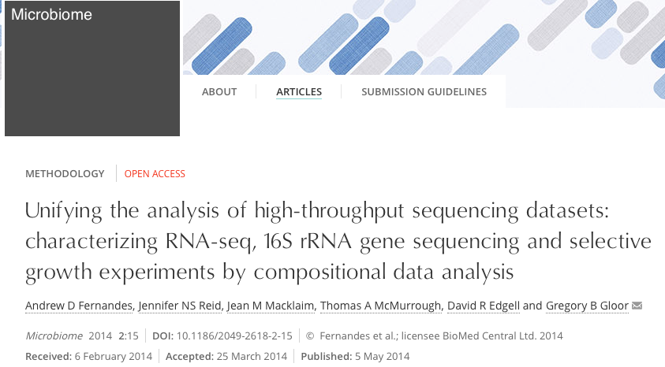


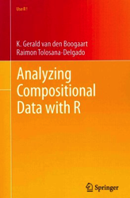
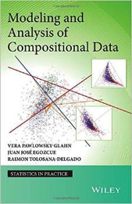
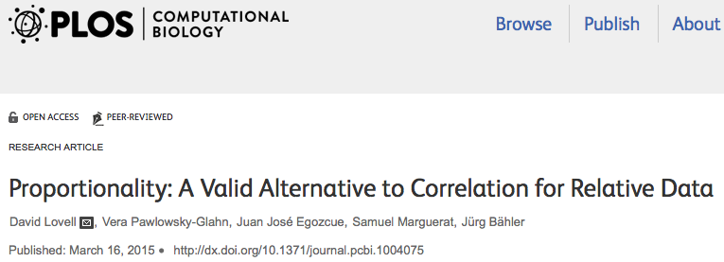
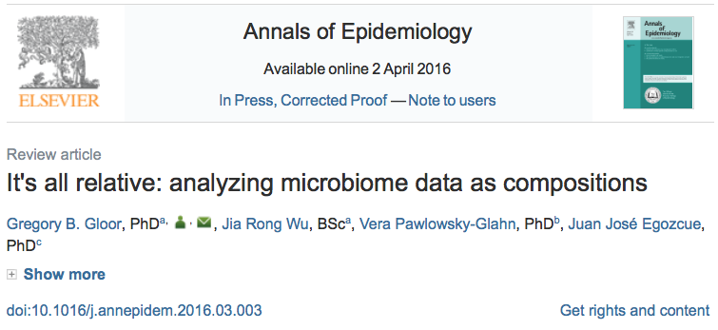

Reading & Sources
🐯
🐞
👽

Slide 47

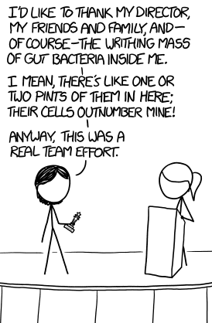

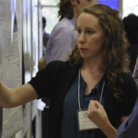



Acknowledgments
🐯
🐞
👽
Andrew
Fernandes
Jean
Macklaim
Vera Pawlowsky-Glahn
Juan Jose Egozcue
Justin Silverberg
🐯
🐞
👽
Gregor Reid
Jeremy Burton
Michael Vu
Jia Rong Wu
Notes:
Many more fragments than we can count

